Slide 1
The Use of Natural Language Processing in Detecting Trends of Cyberbullying in Social Media SITES among Filipino Adolescents
S. Mallari | F. Ballesteros | E. Samillano

Slide 2
Introduction

Slide 3
1.1 Background of the Problem
A brief history on bullying
(How bullying changed over a long period of time)
-Its first discovery on primates
-After the birth of the Homo-sapiens
-Bullying in the 21st century
Bullying-like behaviors are part of the human nature

Slide 4
1.1 Background of the Problem
Introduction to cyberbullying
-General definition of cyberbullying
-Technology = culprit

Slide 5
1.1 Background of the Problem
Cyberbullying in the Philippines
-Why should we be concerned?
-The difference on how we deal with cyberbullying compared to other countries

Slide 6
1.2 Statement of the Problem
How can Natural Language Processing be used to detect trends of cyberbullying in social media among Filipino adolescents?

Slide 7
1.3 Objectives
Apply Natural Language Processing (NLP) technology in detecting trends of cyberbullying in social media sites
To be able to notify the user with regard to the detected trends with the help of ‘flags’

Slide 8
1.3 Objectives
Demonstrate teamwork
Comply to project deliverables on time
Develop communication skills
Contribute information to the body of knowledge

Slide 9
1.4 Significance
Adolescents spend their time on social networking sites more frequently compared to other age groups
-They are still immature
-They are not likely to tell anyone that they are being bullied
Effects of cyberbullying on an individual can spread to people whom that person maintains interactions with

Slide 10
1.5 Scope and Limitations
The project will focus only on the prevention of intensified cyberbullying occurrences among adolescents (aged 10-19 yrs. old), living in Metro Manila, Philippines
Detection of cyberbullying trends is limited to English and Tagalog languages only

Slide 11
Review of related literature

Slide 12
2.1 Specific Definition of Cyberbullying
For an ill-treatment to be considered an occurrence of cyberbullying, the following criteria must be met:
-It should be involuntary
-It should be happening repetitively
-It should have caused a person harm (in any possible way)
-It was done with the help of technology (any of its forms)

Slide 13
2.2 Common Scenarios of Cyberbullying in the Philippines
Cyberbullying cases in the Philippines can be classified under two types:
-cyber mob = involves groups of people holding another person for a misdeed or social blunder (that he/she committed) within the cyber environment
-day-to-day under reported cyberbullying cases

Slide 14
2.3 Efforts Contributed by the Philippine Government to Stop Cyberbullying
Anti-Bullying Act of 2013
-requires schools to come up with policies defining and prohibiting bullying inside or outside the school premises
-the safety of those who will report bullying occurrences must be assured
-admin procedures and corresponding disciplinary actions must also be executed

Slide 15
2.3 Efforts Contributed by the Philippine Government to Stop Cyberbullying
Anti-Bullying Act of 2013
-the school must provide rehabilitation procedures for the bullies
-they must device strategies and procedures on how to record and report a bullying incident
-provide counseling for the victim
-educate the victim’s parents on what they can do to help their child cope with the negative effects of bullying

Slide 16
2.3 Efforts Contributed by the Philippine Government to Stop Cyberbullying
Anti-Cyberbullying Act of 2015
Forms of cyberbullying (as defined by this law)
-repetitively sending rude messages toward the victim
-disclosing derogatory information about the victim
-posting or sending offensive photos of the victim
-breaking into the victim’s personal accounts

Slide 17
2.3 Efforts Contributed by the Philippine Government to Stop Cyberbullying
Anti-Cyberbullying Act of 2015
Penalty
-a fine of 50 000-100000 pesos
-6 months up to 6 years of imprisonment

Slide 18
2.4 Natural Language Processing (NLP): The Basics
Definition
-refers to the utilization of a computer’s capability to process sentences stated in natural human languages instead of specialized computing languages
Differences between NLP and Natural Human Languages
-NLP is only a subset of natural human languages
-”Natural language processing” covers a broad scope

Slide 19
2.4 Natural Language Processing (NLP): The Basics
-The word “processing” in NLP covers both interpretation and generation
Subtopics of Natural Language Processing
-signal processing
-syntactic analysis
-semantic analysis
-pragmatics

Slide 20
2.5 Data Mining and Natural Language Processing Combined
Data Mining
-an interdisciplinary field incorporating techniques from statistics, database, artificial intelligence, and machine learning altogether
Text Mining
-obtaining information from raw textual documents, whether structured or unstructured
NLP and data mining are two different, yet somehow related, concepts

Slide 21
2.6 Products of NLP
Software Applications
Thinknowlogy
Bitextor
TagAligner
RelEx
Wintermute

Slide 22
2.6 Products of NLP
Application Programming Interfaces (APIs)
Text Razor
Stremmor Automated Summary and Abstract Generator
Skyttle 2.0
Textuality

Slide 23
Dataflow Diagrams (dfd)

Slide 24
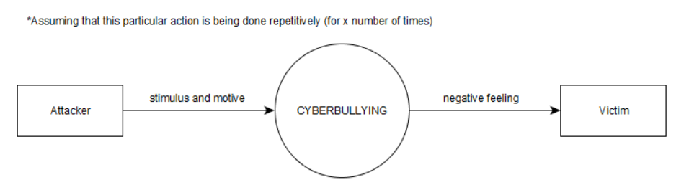
Context Diagram

Slide 25
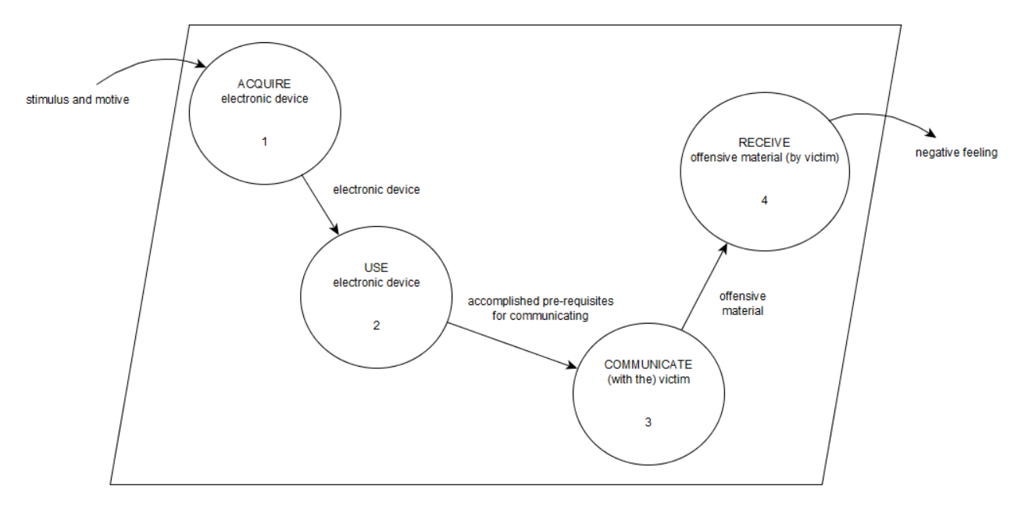
Diagram 0

Slide 26
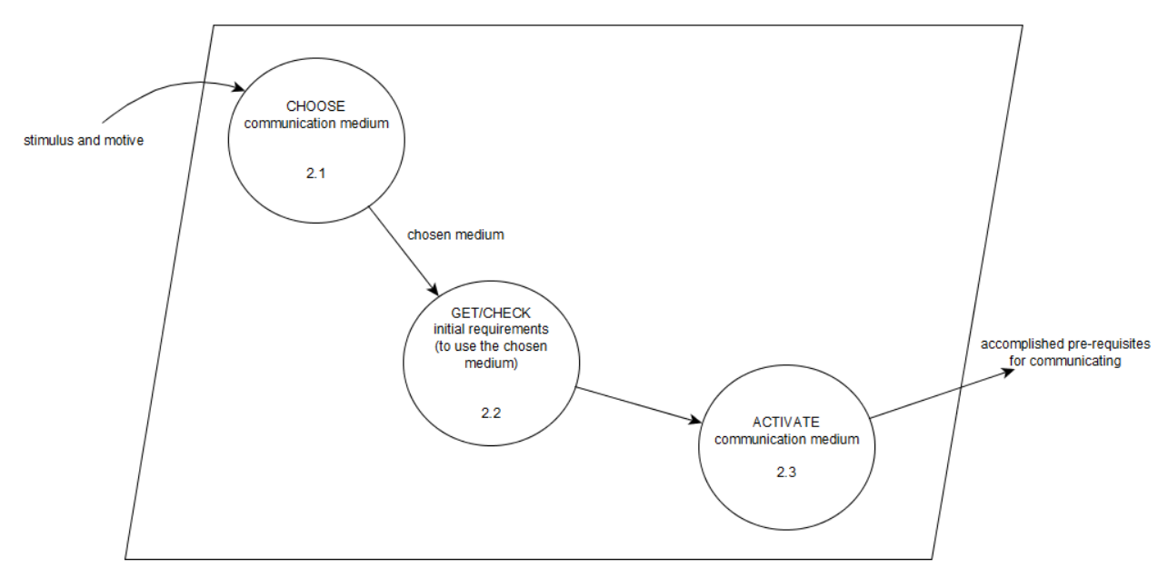
Diagram 2

Slide 27
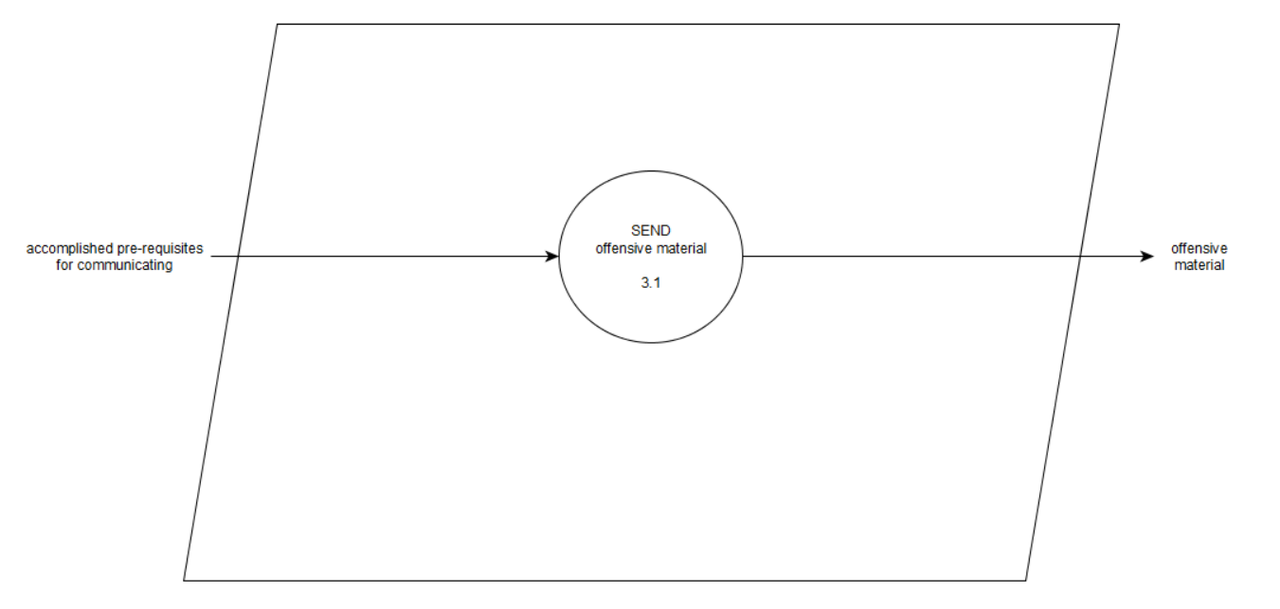
Diagram 3

Slide 28
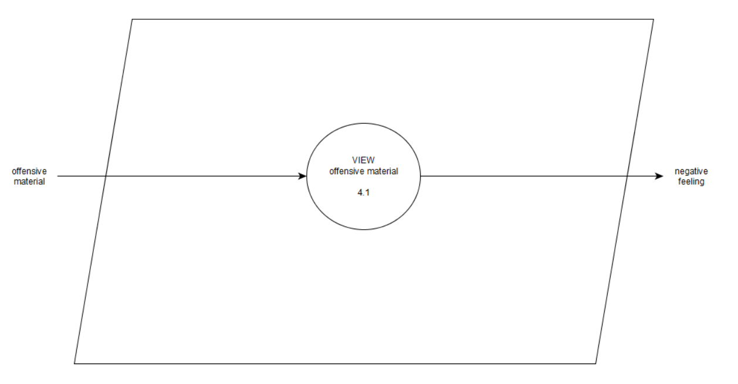
Diagram 4

Slide 29
Data dictionary

Slide 30
Diagram 0
Process 1
electronic device = [smart phone | tablet | desktop computer | laptop | gaming console | smartwatch | iPod | smart TV]
Diagram 2
Process 2.1
communication medium = [e-mail | sms | chat | forum/newsgroup | social media sites | blog | call | video call | instant messaging | voice messaging]
Process 2.2
initial requirements = [internet connection | cellphone load | Bluetooth | mobile data | call cards]
Diagram 3
Process 3.1
offensive material = [text | image | video | voice message]
Diagram 4
Process 4.1
offensive material = [text | image | video | voice message]

Slide 31
Process specifications

Slide 32
Diagram 0
Process 1
The attacker, by any means (e.g. buy a new one, borrow from a friend, etc.), gets his/her preferred device (assuming that he/she owns one or more of the types of electronic devices defined).
Diagram 2
Process 2.1
The bully will select a communication medium (where he/she could execute his/her attack). Typically, this particular medium is the most accessible one to use (for him/her), or this is where the attacker had established a solid group of friends who will be there to act as his/her support (despite the wrongdoing that is going to be committed) to ensure the latter's protection.
Process 2.2
Once he/she (the attacker) has chosen his/her preferred medium, the next step is to make sure that he/she has enabled or acquired the materials needed in order to make the communication (through the medium) possible. This is what this specific process is all about. He/she can look for a Wi-fi hotspot if they are planning to use a communication service on the web, or they can load some balances into their cell phones to express themselves through text. The possibilities will depend on what communication medium he/she has picked.
Process 2.3
In this process, the bully is expected to log-in to an account (or sign-in to create one) that he/she will use to harm the victim (in the event that the attacker has chosen web communication services as his/her medium for sending the offensive material). Opening their sms app from their smartphones can also be included here. Anything that has to do with 'logging himself/herself inside' the medium that was chosen falls under this process.

Slide 33
Diagram 3
Process 3.1
Process 3.1 focuses on the act of reaching-out to the victim by means of sending offensive materials to his/her respective account, inbox (for phones and e-mail), etc. The term 'sending' in this process include posting, commenting, 'tweeting', etc. the offensive material since such things were made visible on that particular website because the bully "sent" them through the network.
Diagram 4
Process 4.1
This final process determines whether the material sent is indeed offensive or not to the victim. There are cases where a particular message will either leave a negative impact on a person or not. It depends on their corresponding views with regard to the thing that was sent to them. This stage is crucial for the development of the project because the only way to find out if the 'flagged' words are indeed cyberbullying trends is by asking that same person as well if it had offended him/her in some way. However, whether or not the user finds a particular word (that was 'flagged'), the system will still need to keep its watch on the pertained words (due to the fact that it might be considered harmful on a different person).

